Slide 1

Datawarehouse and BI Shopify
Group 4:
Prakruti Shah
Ritesh Dhakad
Shivali Naik
Nikhil Damle

Slide 2
Agenda
Overview
Business Processes
Bus Matrix
Dimensional Model
ETL Process
KPIs
Dashboards
Data Governance and Master Data Management

Slide 3
Brief Overview
A startup company created by four young entrepreneurs who have come together to solve a common goal. We have founded an American electronic commerce company called ” Shopify” which is a one of the Internet retailer.
The online shopping site would allow the consumers to directly buy goods or services from a us over the Internet using a web browser. Consumers find a product of interest purchase it from our site and then the product would be ship to the consumers. Through this project, We want to accomplish a few business processes that will measure our success in the online retail business
Goal
Analyze the customer preference and buying pattern
Identify the factors which promotes sales
Data warehouse system answering questions related to
Customer purchase behavior
Identify product categories to be promoted

Slide 4
Sales Analysis Information Categories
Customer Reviews Information Categories
Sales Performance
Corresponding to a particular product department , which product has the maximum sales?
Which month is having maximum sales corresponding to a product department?
Determining sales by product department and product name geographically?
Customer Preferences
Determine each product's average rating to see how a particular product is rated by our customers
Determine the change in pattern of product ratings over specific time frames
Determine the products with the highest/lowest ratings and see if we can change the vendor for that product to improve the product quality and hence customer satisfaction

Slide 5
Bus Matrix
Sales Analysis
Customer Review

Slide 6
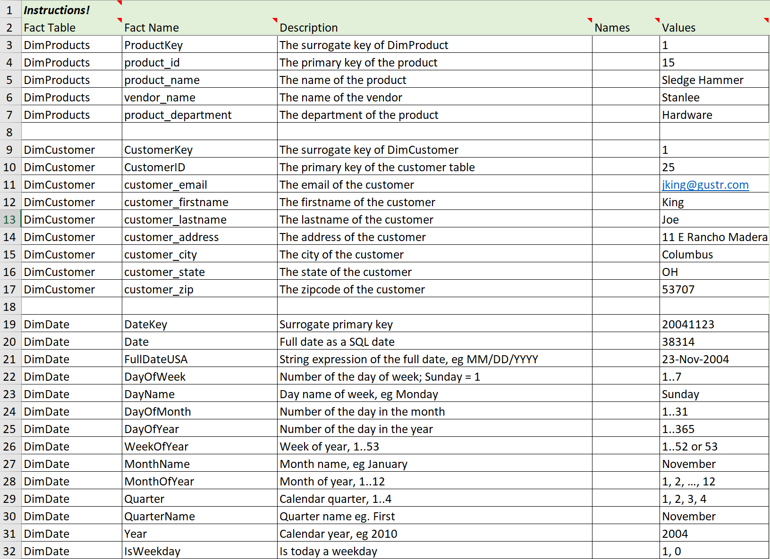
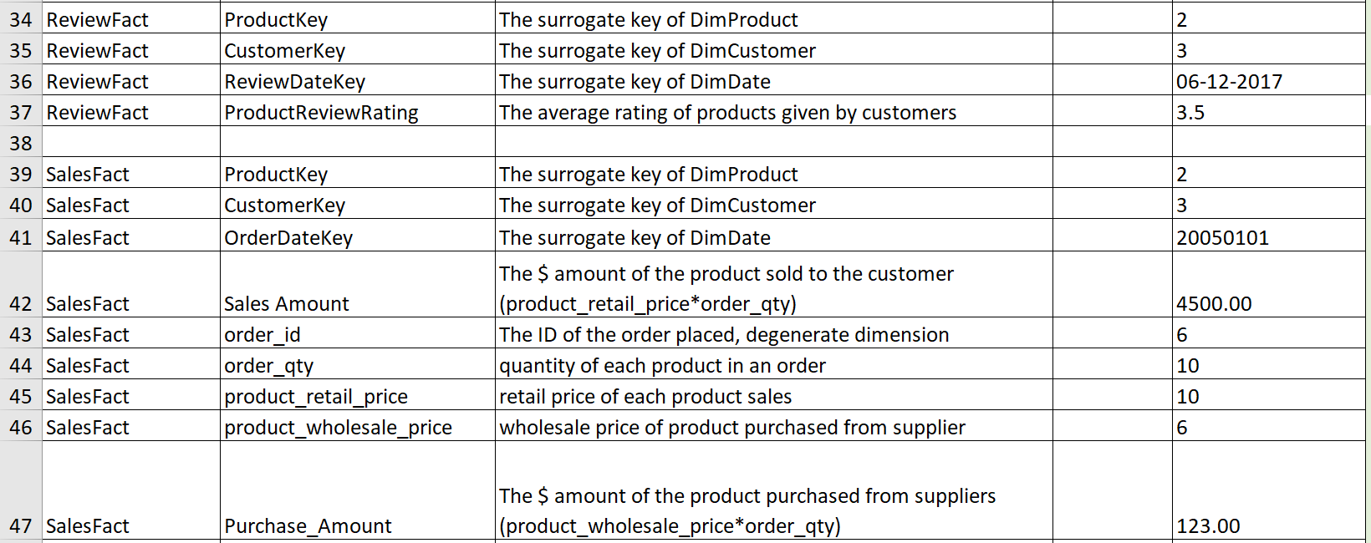
Attributes of Dimensions and Fact tables

Slide 7
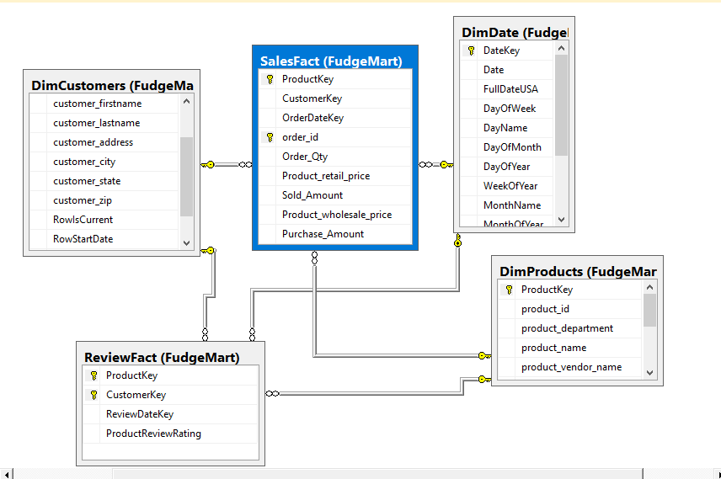
Dimensional Data Model

Slide 8
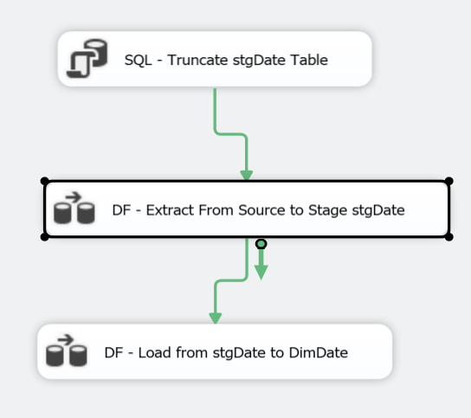
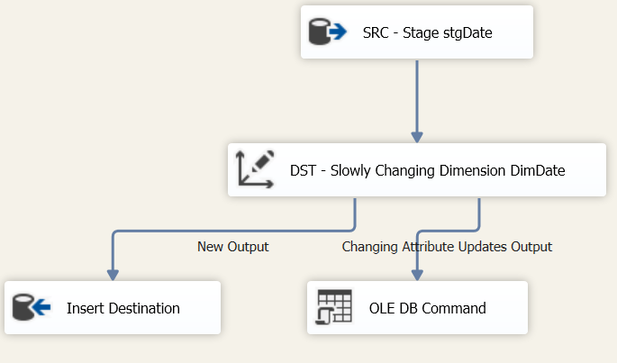
Control & Data Flow of Source to Target (DateDim)

Slide 9
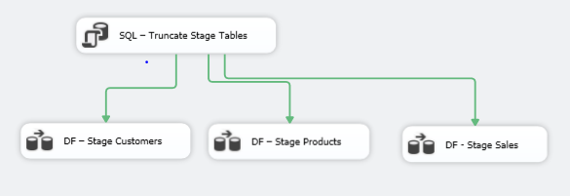
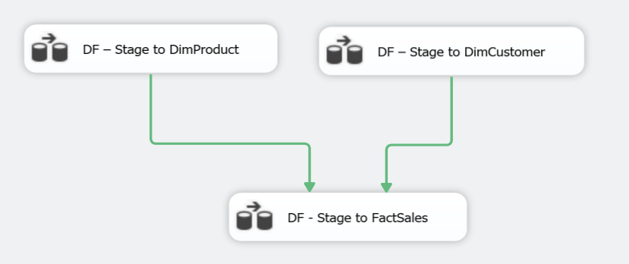
Control Flow of Source to Target (Sales)

Slide 10
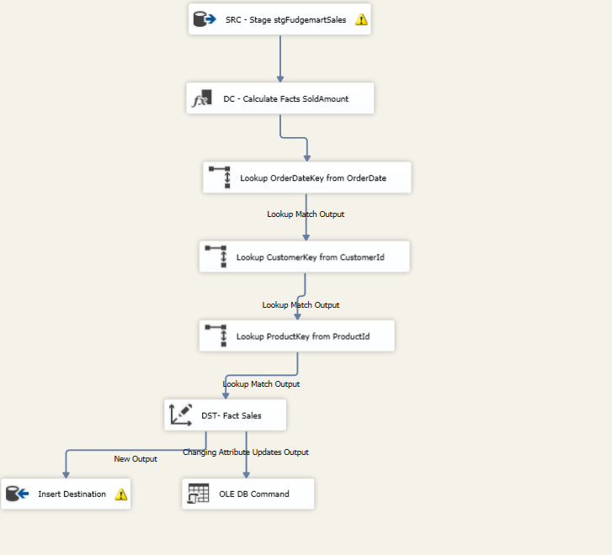
Data Flow of Source to Target (Sales)

Slide 11
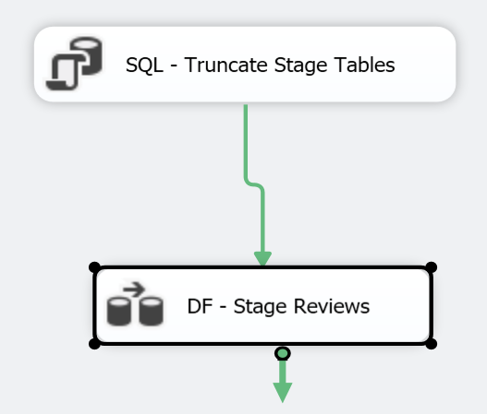
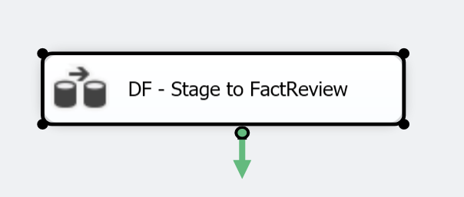
Control Flow of Source to Target (Review)

Slide 12
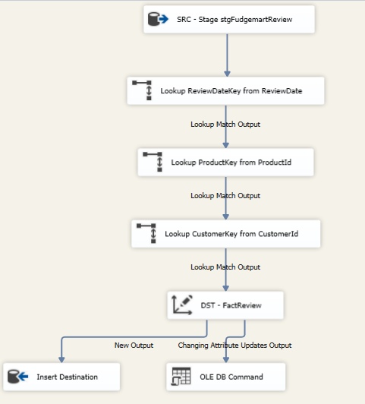
Data Flow of Source to Target (Review)

Slide 13
KPI’s
Sales Analysis
Revenue by product
Revenue by product category
Product | Revenue | Status
Leather Jacket | >=$10,000 <$10,000 | Good Bad
Product Category | Revenue | Status
Clothing | >=$150,000 <$150,000 | Good Bad

Slide 14
Customer Review Rating
1. Monthly rating of products
Product | Rating | Status | Inference
Comfor-fit Tee | >2.5 <2.5 | Good Bad | Vendor is good Vendor is bad

Slide 15
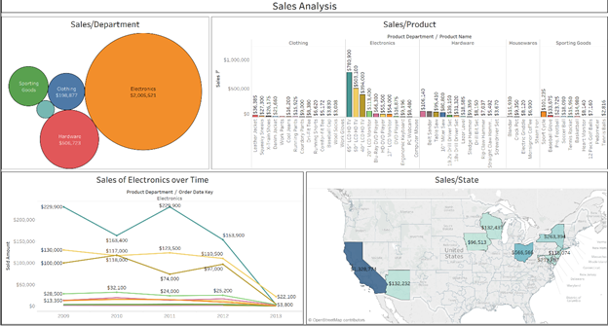
Sales Insights Dashboards

Slide 16
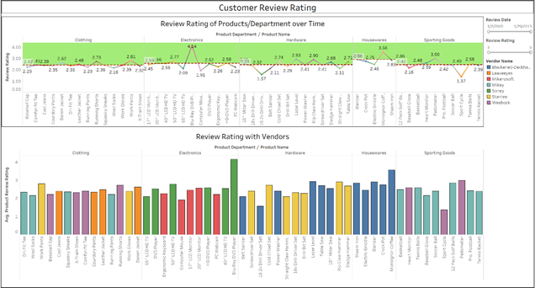
Customer Review Insights Dashboards

Slide 17
Data Governance
Overview of the goals of DG
Be as open and transparent as possible in your policies and procedures.
Support other groups who require use of your data.
Collaborate institutionally to break down information silos. It’s everyone’s data.
Roles in DG
CIO or CDO
Risk Manager
Data Administrator / Data Steward
Data Custodian

Slide 18
Master Data Management
Overview of the goals of DG
Creating a single “Reference Copy” of key business entities.
Examples: Customers, Vendors, Products, Employees
Offers an organization a single version of what “Customer” means.
Helps reduce inconsistencies in data distributed throughout the enterprise.
Aims to provide clean, reliable data.
MDM initiatives will help us create conformed dimensions in our data warehouse, specifically when the dimensional data is sourced from multiple systems.
Roles - Data Administrator / Data Steward

Slide 19
Schedule of events for DG and MDM
Data Governance
Governing Body
Defined Procedures
Execution Plan
Master Data Management
Develop Dimension

Slide 20
Thank You

